Slide 1


Product Strategy

Slide 2

AGENDA
Our Understanding
Scope Outline
Proposed Approach
Team Structure
Key Assumptions and Risks
Why Capgemini
Commercials
About Capgemini

Slide 3

01
OUR UNDERSTANDING

Slide 4







Vision
Transform into new age Media-Tech company
Reach out to the Local & Global Tamil Diaspora
Strengthen existing and develop new Digital Products to generate new revenues
Enable community building by offering user-friendly digital services

Slide 5
Our understanding of Daily Thanthi’s Objectives
Daily Thanthi would like to review the existing digital ecosystem and be advised on building digital assets with cutting edge technologies with the desire to be know as media tech company. With Strategic and integrated transformation approach DT to drive efficiency and incremental returns in the short and long term
Provide
Strategic Roadmap
for improving existing products and new product launch and growth
Looking for an
Advisory Partner
to study DT’s Business model and advise on new opportunities and transforming digitally for future growth
Partner with Business team to Assess Existing Digital Products and Identify and develop new Services/ Product
Provide
GTM strategy
for the new product to widen the customer base and increase DT revenues

Slide 6
02
SCOPE OUTLINE

Slide 7
03
PROPOSED APPROACH

Slide 8
Proposed Approach – PHASE 1
PHASE 1: Product definition & GTM strategy
Week 1 to 6
Week 7 to 15
Week 13 to 17
      ASE 1
      ASE 2
0
2
3
Existing Product Portfolio Assessment
New Product Detailing & GTM Strategy
MVP Design and Roadmap
Study existing portfolio and do Competitive analysis to assess gaps
  Detail Product Definition and Go-To-Market (GTM) strategy
  Define product and develop high-level product design
1
New Product Definition
  Evaluate different Ideas / Initial set of Product Offerings
Deliverables
  Assessment of existing DT products (heuristic evaluation)
  Opportunity/ Service Offerings (Analysis of 10-12 new services)
  Concept MVP
  Target audience definition (demographic/ psychographic assessment; mind map of customer journey)
  Pricing & Promotion strategy
  Detailed product definition
  MVP Design (Thanthi Whistle plus the new product)
    Wireframes (low-fidelity; up to 20 screens)
    Development-ready designs (high-fidelity; up to 20 screens)
  Product Roadmaps (new product)
  Improvement plan for existing DT products

Slide 9
Step 1: New Business Ideas – Opportunity briefs preparation
Matrimonial – Facilitate virtual meets
Automobiles
Real estate
Financial services
Insurance
Similar to Amazon, Myntra
TN specials like Kancheepuram sarees
Making use of huge ground force – Reporters, Agents, logistics
DT Market Place
Classifieds
    Citizen reporting
    Opinions
    Reviews
Addressing the local market (Hyperlocal) based on Segments,
Pin code
(Plumbers, Maids, Electricians, Drivers)
Citizen Journalism
New Business IDEAS
Uberization of Services
Points
Likes
Comments
Badges
Connect multiple services
Hyperlocal
Digital healthcare services (Alliance with Practo, Portea, NetMeds, etc.)
Gamification
Super App
Other new
Ideas
Tie up with Schools and Colleges
App based learning
New generation to learn Tamil
Edutech
Films – Movie reviews, celebrity jazz, Filmfare
Kollywood Stock exchange
Crypto Currency
OTT Platform aggregator
Customer data collected and AI based smart solutions to segregate information for various marketing purpose
Ad tech – Own Servers, Ad Networks, Connect with Publishers….

Slide 10


Step 2: GTM Strategy
  We will develop the understanding of our target audience
    By identifying segments and attributes to define our core group and a suitable product positioning that best communicates our value proposition to that core group.
    Outlining our core group’s personas/ archetypes (a choice based on how much data and time we have)
    Creating a mind map that will outline our target group’s likely journey when using our product/service/basket of offerings.
  Further develop the definition of our product/service, its functions and features, its key assets, how it might evolve through its lifecycle, and, if possible, identify complimentary services and assortments of services it can be bundled with.
  Impact on existing portfolio (sales, brand)
  Make recommendations around the pricing strategy* & tactics
    Evaluate strategies like Freemium | Subscription tiers | One-Time Price | Psychological Pricing | Demand-Based
  Promotion of the product/service will include content & communications strategy, tactics, and channel strategy.
    This will include brand messaging around the identified value proposition and positioning, a content disbursement roadmap, sample marketing collaterals, and key metrics to track
  Distribution Strategies (direct versus hybrid; i.e., company-owned versus online-only retailers, omni-channel retailers, value-added resellers, partners, franchisees), goals, key metrics
  (*) Exact price of each offering selected is NOT factored in at this point. This outcome can be revisited, if desired, once we zone in on our exact product/service offerings.
Company Confidential © Capgemini Invent 2021. All rights reserved |
28

Slide 11
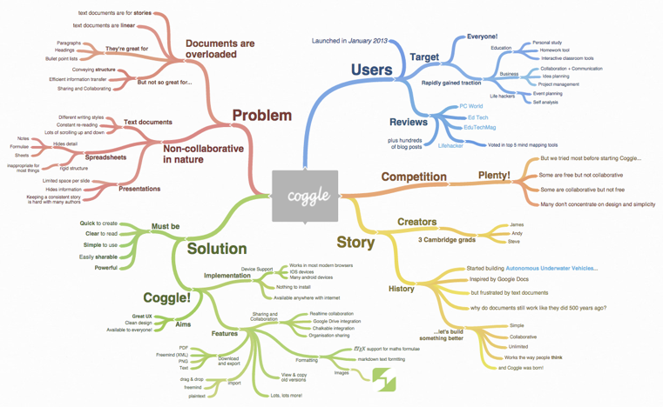
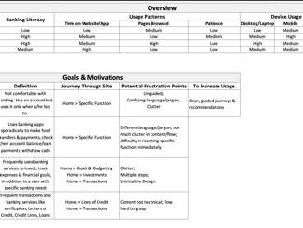
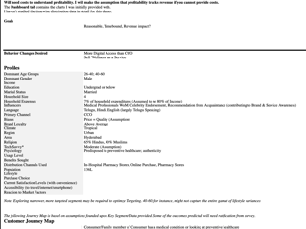
Step 2: GTM Strategy
Sample Deliverables
Representative image of a mind map - defines the customer journey
Audience Archetype for Financial Services Company
Audience Segmentation for a Life Sciences Company

Slide 12

Step 3: Concept Design & Product Roadmap
  Recommendation roadmap that will outline
    Vision
    Direction
    Priorities
    Pricing changes
    Product maturity over its lifecycle
      Key metrics to track
      Skillsets, tools, costs required to build product
      Vendor partnerships (if there is an opportunity to consider)
      High-fidelity product mock-ups
Company Confidential © Capgemini Invent 2021. All rights reserved |
31

Slide 13
04
KEY ASSUMPTIONS AND RISKS

Slide 14
Assumptions
Project Execution | The project would be executed remotely or with limited in person discussion due to the ongoing covid-19 pandemic.
Stakeholders Availability | Daily Thanthi Group will ensure availability of internal stakeholders for interviews and workshops. They will help Capgemini team in scheduling the activities. Daily Thanthi will nominate a Transformation Program Manager who will in-turn bring other Business and technology SPOCs as relevant
Interviews & Workshops | Daily Thanthi Group will communicate to the interviewees/ participants/ stakeholders and ensure their availability as per the project schedule
Deliverable Sign-off | Daily Thanthi Group will review and sign-off deliverables within 3 working days of submission. Deliverables will be deemed accepted if we do not receive any feedback within 3 working days of submission
Request for Data/ Information | Vision & Business Objectives, Business Processes, IT landscape and other documents ready for consumption will be required at the start of the engagement will be provided by the DT team. DT Group will provide relevant data/information that will be needed for analysis and deliverables at the start of phase/ activity Requested inputs will be responded within decided timelines Any access to the environment to DT systems will be provided by the DT group. We will need data on current KPIs/ Cost/ production process/inventory management etc.. from DT Group
Status Meetings | Capgemini team will schedule regular status meetings, DT Group chosen participants are expected to attend and align for the status
Business Impact | Business Impact is the view of the benefits are from a stakeholder point of view
Ease of Implementation | The ease of implementation will factor in DT’s IT view and dependencies across programs. DT Group will provide a walk through of all the ongoing Digital capability building initiatives.

Slide 15
Risks & Mitigation
Risk | Mitigation Action | Risk Impact
Timely Decision Making | Based on our experience, delayed decision making has significant impact on transformation programs Identify empowered, decisions makers early as part of the program plan Capgemini will support with full information for decision-makers to take timely decisions | Critical
Availability of key stakeholders during workshops | The key stakeholders will be notified well in advance about their participation for the workshops / one on one sessions | High
Delays in reviews & Approvals Process | Capgemini team will share the documents / deliverables in advance with clear expectation on approval timeline | High
Detailed information about existing ways of working /as-is processes and technology may not be available | Capgemini team to share the information needed beforehand with the DT team | High

Slide 16
05
WHY CAPGEMINI

Slide 17
Our Value Proposition – Why choose Capgemini
Our value proposition is based on 4 key pillars that will enable an accelerated start and set Daily Thanthi up for success.
OUR PEOPLE
OUR EXPERIENCE
OUR CORE SERVICE OFFERING
OUR IP AND ASSETS
Our People
Included in our team are individuals who have extensive combined experience across Media and Entertainment, Advisory and Implementation roadmap, Operating Model Design and Implementation, Change Management and Training design and delivery across a wide range of industries and clients both locally and globally
Our Assets and Accelerators
We bring our proven propriety IP, assets and accelerators such as our Accelerated Solution Environment sessions and proven frameworks (incl. Ideation, Capability Assessments, and tools), Operating Model Frameworks and Methodologies and our Change Management toolkit.
Our Experience
Locally and globally, we have successfully delivered a wide range of Media & Entertainment advisory engagements, Digital Transformations, operating model/framework designs and implementations as well as change management activities,
With our Implementation experience we bring practical advice, grounded in delivery reality, not just theory.
Our Core Service Offering
Our offering for a Media and Entertainment operations assessment helps businesses establish a prudent strategy for Digital Transformations, while saving time and decreasing lost revenue. We believe it is important for businesses to maximize value from their operations, but also protect their interests and minimize value leakage. We recognize this, and tailor our approach accordingly to look after your best interests.

Slide 18






The media industry is at a crossroads.
Adapt to the ever-changing ecosystem.
I wouldn’t use the word “ prepare to be left behind”
Big Bets
Big Bets
Big Bets
Big Bets
Big Bets
Big Bets
Changing competitive landscape
Mergers and acquisitions
Changing consumer behavior
Content distribution across platforms
Advertiser expectations
Privacy and security
Creating on-demand streaming trends are vastly growing as VOD, SVOD, TVOD, and AVOD streaming TV usage nearly doubles in less than two years.
Creative media and tech companies have changed the industry landscape, including with major M&As from Disney (Fox), Viacom (CBS), ATT (Time Warner) over the past two years
Understanding consumer interests is the key to generating content relevant to them, enabling personalized advertising
Reinvent customer engagement to drive relevance in a convergent world
Developing new opportunities to launch and support the impending 5G disruption
The future of the security business in the evolving, connected, digital and physical ecosystem

Slide 19





Linear TV – Digital – OTT Experience and Focus areas
Ad Sales
Production, operations, and distribution
Sports
News and Publishing
Analytics and Consumer Intelligence
01
02
03
04
05
Linear & Digital Sales Rationalization
Viewership Forecasting
Unified Campaign Management
Optimized Ad Impression
Audience targeting platform
Forecast management with AI/ML
Programmatic ad sales
Sales availability and contract administration for licensing television products through the television mechanism of delivery, which includes pay television, pay per view, free television, and basic cable​
Implementation and ongoing support to develop, produce and schedule, promote
Enterprise-level event management handling 487+ events per year with 10,000 crew, hiring for 8,000 positions, ancillary systems to track effort, expenses, and run payroll
End-to-end analytics for OTT platform, e.g. Sports Gold
Ratings forecast and campaign management
Ingest content from multiple sources i.e. live, archive, tape. Media Asset Management manages media assets archive to distribution
Faster news by collaboration and end-to-end workflow management
End-to-end analytics to handle major events e.g. three Summer and three Winter Olympics and ongoing focus on advance ad sales
Consumer Intelligence
Audience Assurance Analytics
Key Reference Accounts

Slide 20
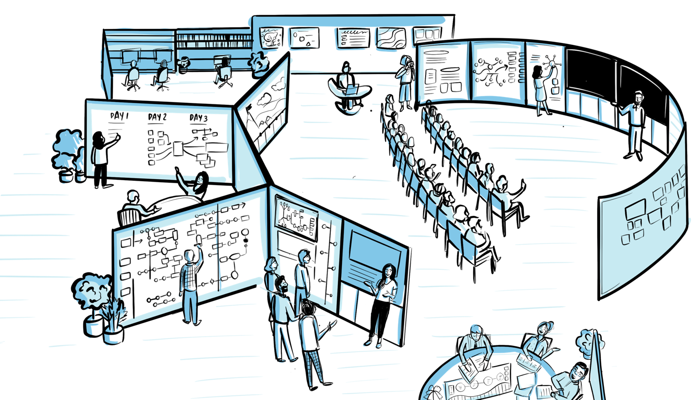
Accelerated Solutions Environments (ASE)
Capgemini proposes its proprietary “Accelerated Solutions Environment” which brings a
unique combination of a creative environment and an approach designed to drive key decisions and stakeholder alignment
The ASE is the unique combination of a creative environment and a proven methodology designed to speed up decision making and alignment.
The ASE takes place in ASE centres, specially developed by Capgemini for this purpose, which provide an unique, creative environment and specially trained moderators​

Slide 21
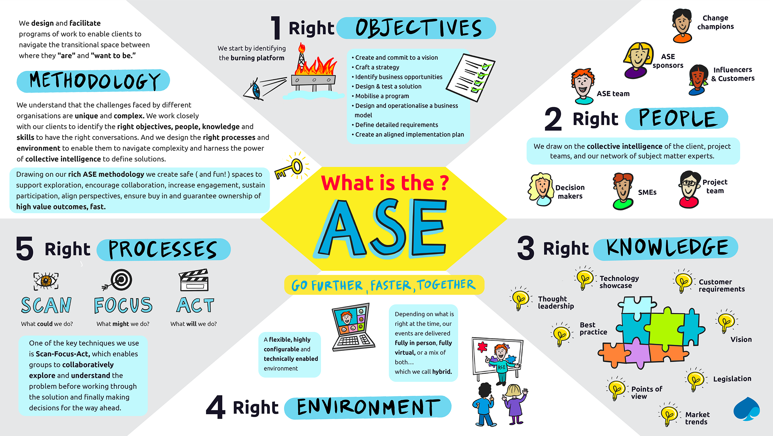

Slide 22
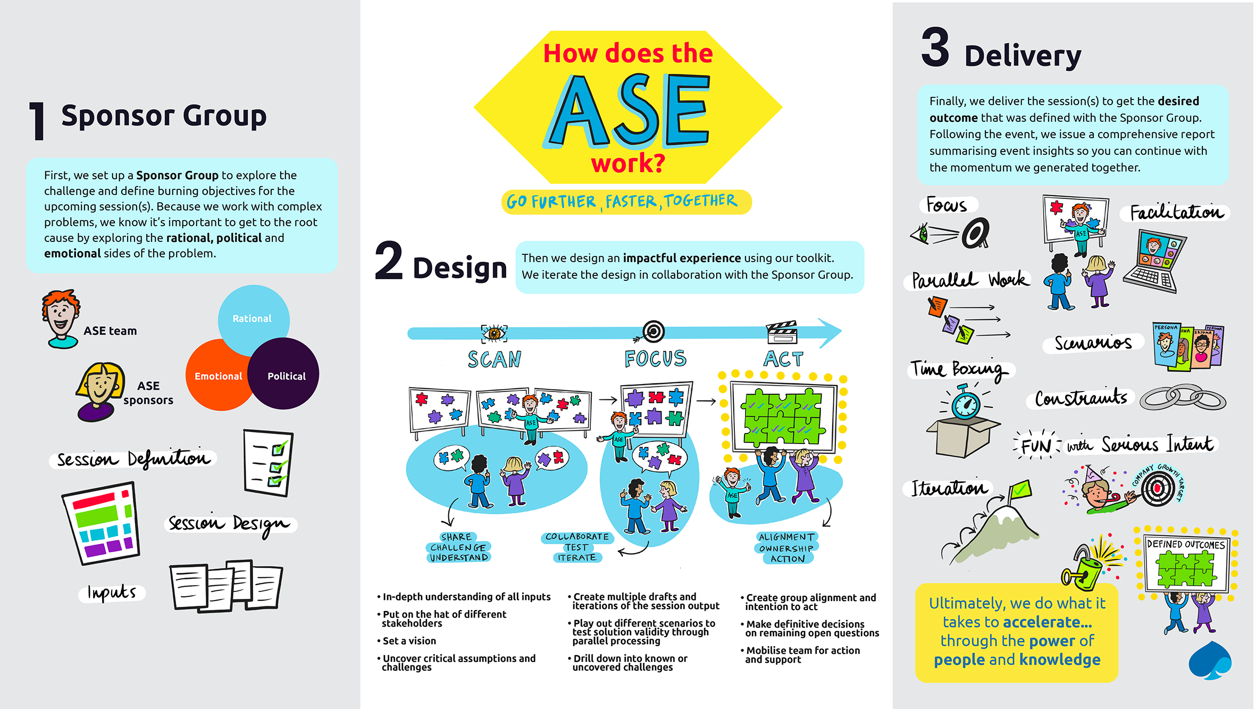

Slide 23
06
ABOUT CAPGEMINI

Slide 24



A complete range of businesses
We are 270,000 people, passionate about helping our clients solve their most complex business and technology challenges, and we deliver transformational outcomes at scale.
We are driven by the conviction that the business value of technology comes from and through people.
Capgemini Invent is the Group’s digital innovation, consulting and transformation brand.
They bring to life what’s next for their clients by combining strategy, technology, data science and creative design expertise.
Capgemini Engineering combines, under one brand, the world leading engineering and R&D services of Altran – acquired by Capgemini in 2020 – and Capgemini’s digital manufacturing expertise. It helps its clients unleash the potential of R&D, a key component of accelerating their journey towards Intelligent Industry.
Sogeti works closely with its clients at a local level and mobilizes expert teams that create custom solutions from existing and emerging technologies to deliver viable outcomes at speed.

Slide 25
About Capgemini
Capgemini is a global leader in partnering with companies to transform and manage their business by harnessing the power of technology. The Group is guided everyday by its purpose of unleashing human energy through technology for an inclusive and sustainable future. It is a responsible and diverse organization of over 300,000 team members in nearly 50 countries. With its strong 50-year heritage and deep industry expertise, Capgemini is trusted by its clients to address the entire breadth of their business needs, from strategy and design to operations, fuelled by the fast evolving and innovative world of cloud, data, AI, connectivity, software, digital engineering and platforms. The Group reported in 2020 global revenues of €16 billion.
Get The Future You Want | www.capgemini.com

